Slide 1

Final Project Presentation
Hemant Suresh – 2019102016
Aravind Narayanan - 2019102014

Slide 2
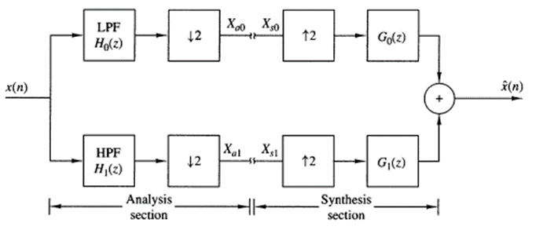
Project Abstract
Our project aims to discuss Multirate Signal Processing and suggests methods for achieving low complexity in Two-Channel Multirate Filter Banks. The base filter bank discussed in this project would be a Two-Channel Quadrature Mirror Filter Bank as shown in figure. We will be demonstrating the purpose of each component in this QMF bank which will then be extended to better filter design techniques and optimizations in the analysis and synthesis banks.

Slide 3
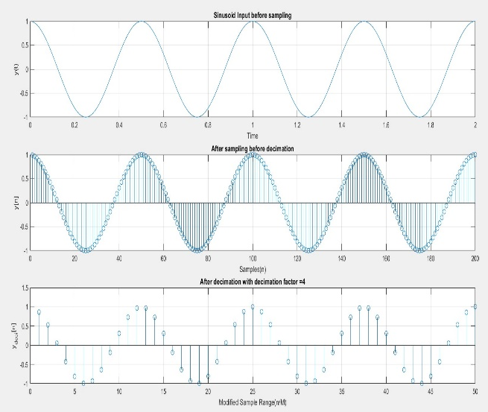
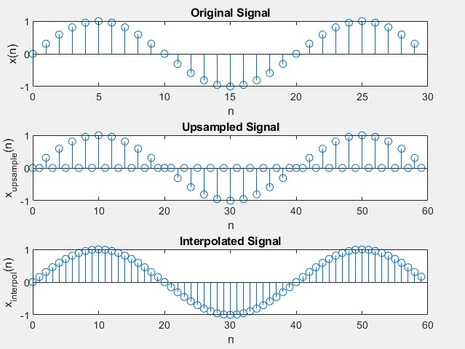
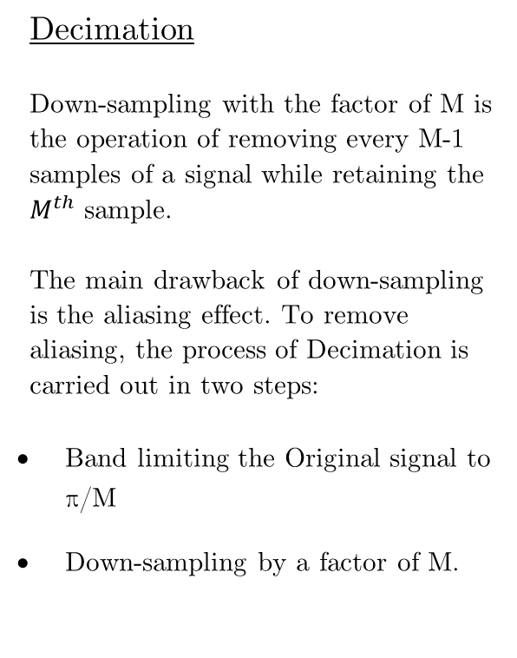
Background Theory
Decimation
Down-sampling with the factor of M is the operation of removing every M-1 samples of a signal while retaining the $M^{th}$ sample.
The main drawback of down-sampling is the aliasing effect. To remove aliasing, the process of Decimation is carried out in two steps:
Band limiting the Original signal to π/M
Down-sampling by a factor of M.
Interpolation
Up-sampling with a factor of L is the operation of adding L-1 zeroes between every consecutive sample.
The main disadvantage of Up-sampling is the unwanted L-1 images formed due to inserting the L-1 zeroes. To remove these images, the process of Interpolation is carried out in two steps:
Up-sampling the input signal by inserting L-1 zero samples between consecutive samples.
Removal of the resultant L-1 images from the spectrum of the Up-Sampled signal.

Slide 4
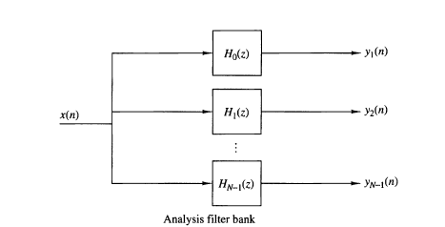
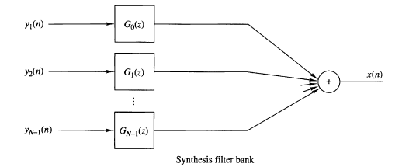




Digital Filter Banks
Filter banks are generally categorized as two types, analysis filter banks and synthesis filter banks. An analysis filter bank consists of a set of filters, with system functions $H_{k}(z)$, arranged in parallel. The frequency response characteristics of this filter bank split the signal into a corresponding number of sub bands. On the other hand, a synthesis filter bank consists of a set of filters with system functions $G_{k}\left(z\right)$. Both are shown in the figure.
The outputs of these filters are then summed to receive x(n). In the figure, H0(z) and G0(z) are called Prototype filters since the rest are just frequency shifted versions shifted by multiples of 2π/N. Hence we can write the general form of Hk(w) as:
Here, h0(n) is the impulse response of the Prototype Filter

Slide 5
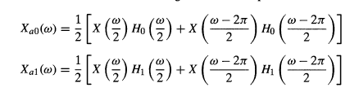




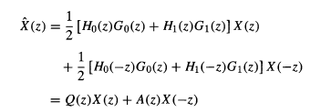

Two-Channel Quadrature Mirror Filter Bank
As discussed in Digital Filter Banks, here we have the Prototype Filters and just one other band. We take H0(z) here as the low pass filter and the shifted version H1(z) as a high pass filter. After Decimation we can express Fourier Transforms of the output as:
For the current situation we consider that no operation happens in the Processing Unit between Xa and Xs. Hence, we can substitute the values of output of decimation in
We get:
We can simplify the equation with
to get
Here we define $V_{0}(z)$ as the distortion function of the QMF bank. $V_{1}(z)$ represents the aliasing transfer function which is to be eliminated.

Slide 6
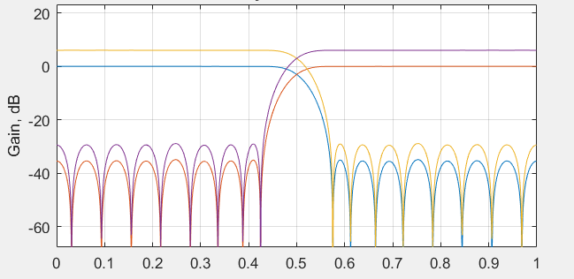
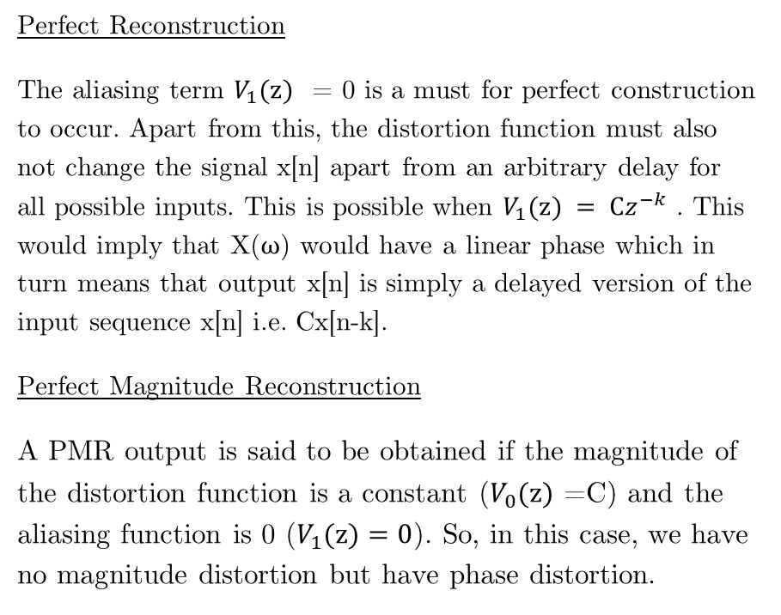
PR and PMR
Perfect Reconstruction
The aliasing term $V_{1}(z)$ = 0 is a must for perfect construction to occur. Apart from this, the distortion function must also not change the signal x[n] apart from an arbitrary delay for all possible inputs. This is possible when $V_{1}(z) = Cz^{−k}$ . This would imply that X($ω$) would have a linear phase which in turn means that output x[n] is simply a delayed version of the input sequence x[n] i.e. Cx[n-k].
Perfect Magnitude Reconstruction
A PMR output is said to be obtained if the magnitude of the distortion function is a constant ($V_{0}(z)$ =C) and the aliasing function is 0 ($V_{1}(z)=0$). So, in this case, we have no magnitude distortion but have phase distortion.
Result of 2-Channel Quadratic Mirror Function.
(Individual Plots are in the Result Folder)

Slide 7

Problem Statement – Digital Filter Design
Problem Statement: Show Report
Our goal is to reduce the overall complexity of the filters.
So we design analysis filters with very-low complexity in both Digital and Hybrid Filter Banks. Then we can get the low-complexity Synthesis filter by simply interchanging them.
Proposed Digital filter bank (Shown in figure) are approximately PR Filter Banks. The Filter Bank is designed by first optimizing Digital and Analog Analysis filters first followed by the Synthesis Filter Bank.
The Digital Filter Bank contains filters that are Equiripple Elliptic Half Band IIR Filters designed using closed-form solutions.

Slide 8
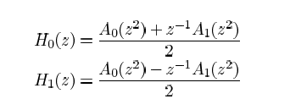




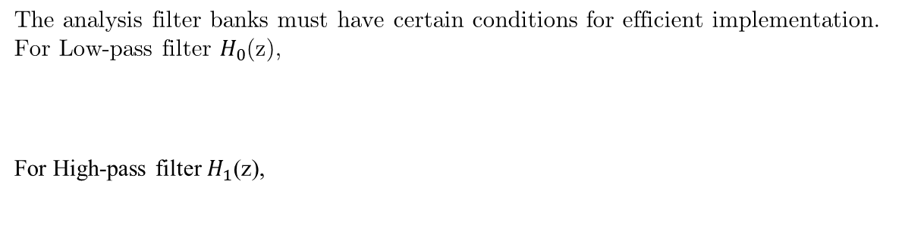

Digital Filter Design – Analysis Filter
Here we take half band IIR low pass and high pass filters which can be written in Polyphase form as:
Here, we take $A_{0}\left(z^{2}\right)$ and $A_{0}\left(z^{2}\right)$are both real, causal all-pass filters. So, the low pass can be expressed as:
Here $φ_{0}\left(w\right)$ and $φ_{1}\left(w\right)$ are phase responses whose passband differs by pi in the stop band which would imply that $H_{0}\left(e^{jw}\right)$, $H_{1}\left(e^{jw}\right)$ would behave like a low-pass response and high-pass response respectively. This is of the form of an Elliptical Filter. Thus, Elliptical Filters are used to achieve low complexity.
The analysis filter banks must have certain conditions for efficient implementation. For Low-pass filter $H_{0}$(z),
For High-pass filter $H_{1}$(z),

Slide 9

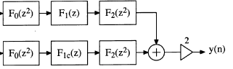

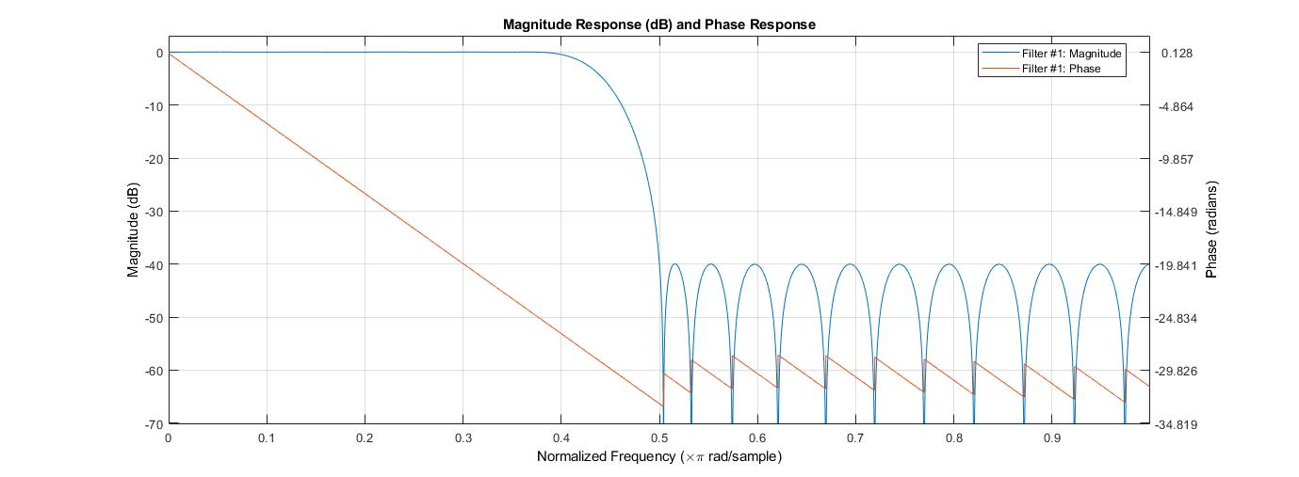

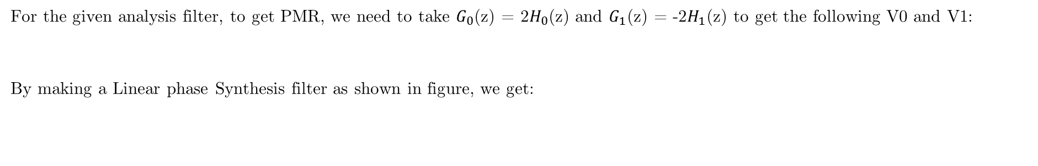
Digital Filter Design – Synthesis Filter
For the given analysis filter, to get PMR, we need to take $G_{0}$(z) = 2$H_{0}$(z) and $G_{1}$(z) = -2$H_{1}$(z) to get the following V0 and V1:
By making a Linear phase Synthesis filter as shown in figure, we get:
Here F0 is used to reduce/eliminate phase distortion while $F_{1}$(z), $F_{1c}$(z) and $F_{2}($z) help to reduce aliasing and maintain magnitude distortion.
Hence, we can get two cases: When Aliasing function=0 and when it is very small,
To achieve Aliasing function=0 we use the Parks McClellan Algorithm for the required optimization purposes.
Parks McClellan is an iterative Algorithm used to find the optimal FIR Filter. We can also minimize the error in passband and stopband by using Chebyshev Approximation.

Slide 10
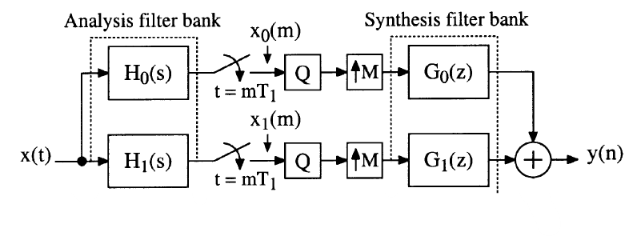



Hybrid Filter Design
For Hybrid Analog/Digital Filters, the Analysis Filter is Analog while the Synthesis filter is Digital.
To minimize aliasing in this filter bank, we consider that the output is bandlimited to π/T. This is done so that the Nyquist value for sampling would be 1/T.
For the given Filter in the figure we can write Frequency response as:
Here V0 and V1 are:

Slide 11
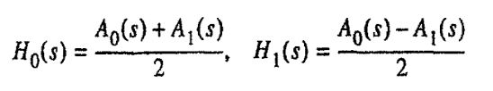


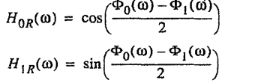
Hybrid Filter Design – Analysis Filter
The low pass and high pass filters in the analysis filter banks are expressed as a sum/ difference similar to all pass stable filters can be written as follows in the s-domain.
We again use elliptic filters to achieve this configuration. As we express them as sum of two all-pass filters, the number of parameters required to individually describe them reduces hence less storage requirement. Although this is not preferred to keep in parallel directly, so a ladder structure is preferred.

Slide 12

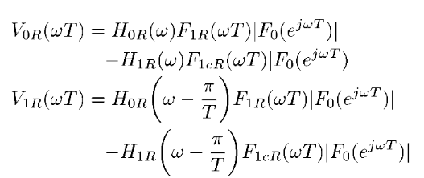
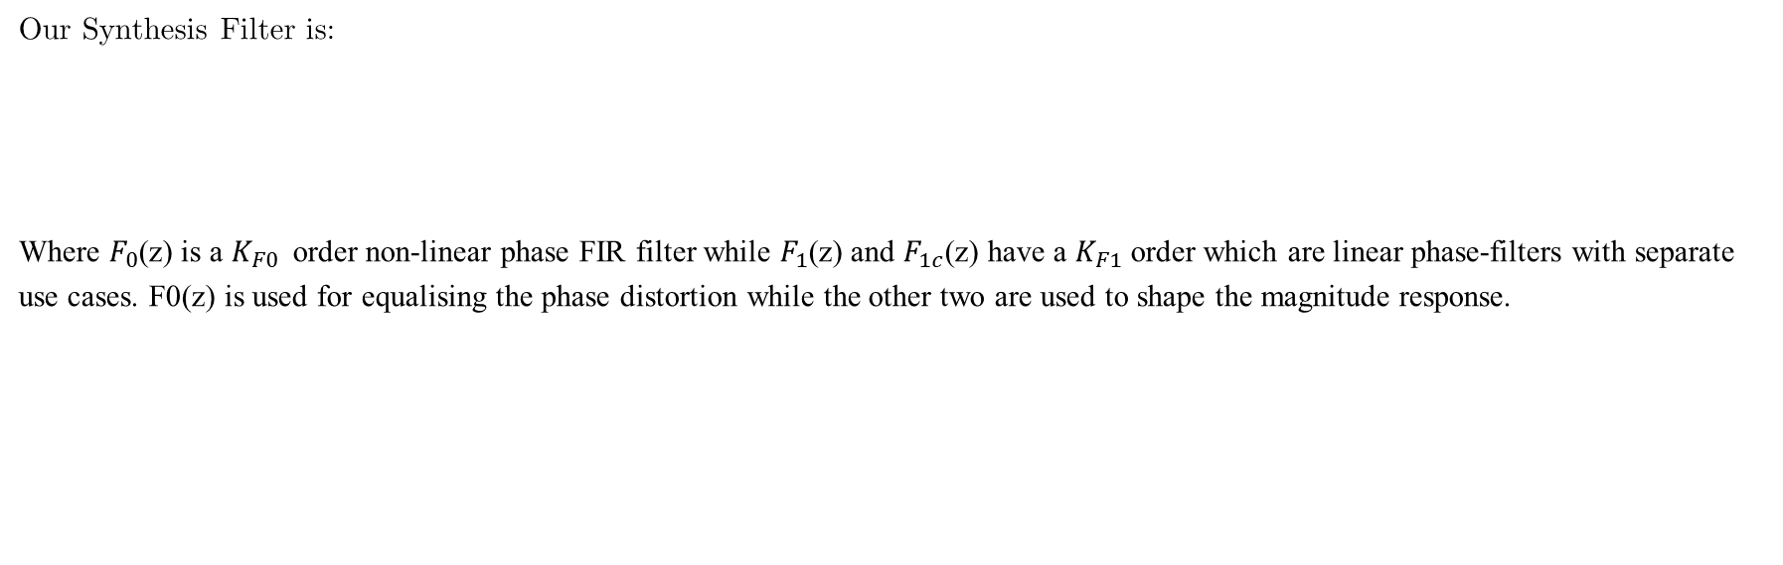
Hybrid Filter Design – Synthesis Filter
Our Synthesis Filter is:
Where $F_{0}$(z) is a $K_{F0}$order non-linear phase FIR filter while $F_{1}$(z) and $F_{1c}$(z) have a $K_{F1}$ order which are linear phase-filters with separate use cases. F0(z) is used for equalising the phase distortion while the other two are used to shape the magnitude response.

Slide 13




Hybrid Filter Design – Filter Conditions
For Low-pass filter H0(z),
For High-pass filter H1(z),
The first two conditions are like what is taken in the digital filter. The extra condition for the magnitude to be zero is due to the following: We have that f1[n] is antisymmetric, so $V_{1R}$(0) = $H_{0R}$(-jπ/T)$F_{0R}$(0) as $F_{1R}$(0) = 0. This will lead to aliasing at every + jπ/T and -jπ/T as F(z) due to which we prefer to keep a zero-pair at those points.
We can see that $H_{0}$ (jw) and $H_{1}$(jw) are power complementary FIR filters and we use Equiripple Approximation to satisfy it.

Slide 14
Conclusion
This project focuses on introducing multirate signal processing and Quadrature Mirror Filter Banks. Both digital and hybrid analog/digital filter banks have been discussed in brief along certain filter design techniques and optimization methods used to obtain a lower complexity. The reference research paper considered uses both the
We discuss some filter design techniques and optimisation methods to obtain a lower complexity for application. The synthesis filters in both the cases are digital FIR filters. Only the analysis filter types differ in both the cases i.e. using digital IIR filters and analog filters in digital and hybrid analog/digital fillers.
First the improvements to be done as done for analysis filters then we move on to synthesis filters. By reducing the individual complexity of each aspect, we are able to obtain a computationally less complex filter design in digital. We do not go into detail for hybrid analog/digital filters due to the less availability of papers in this field.

